Slide 1
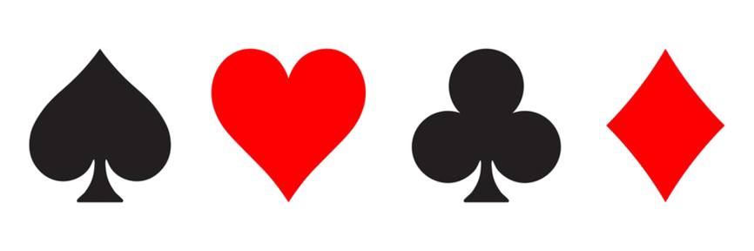
Recognizing playing cards
with federated learning
Project Group 4:
Fabian Bhiladvala,
Julia Fernler,
Love Hedelius,
Hanna Rosenberg
EITP40 - Machine Learning for Internet of Things
2025-12-18

Slide 2
Project overview
Picture processing
2. On device training
3. Weight transmission from peripheral to central
4. Model aggregation and updating
5. Update back to all weights
6. Improved predictability

Slide 3
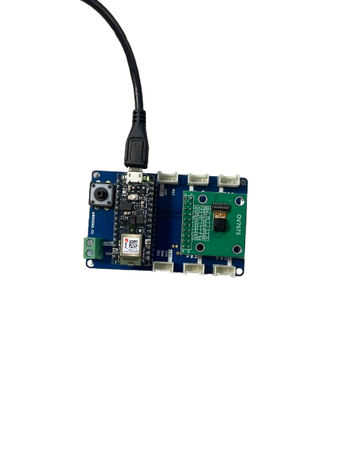
Hardware
Arduino Nano 33 BLE Sense
Used to create a machine learning model
Fully connected neural network
Bluetooth communication used to send data between devices
Camera module (OV7675)
Was not used in final project due to image quality issues

Slide 4
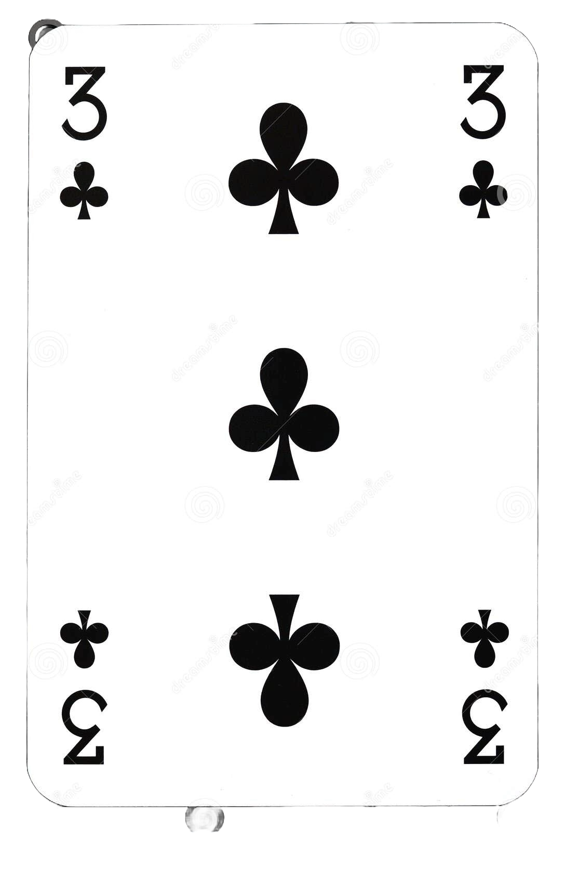
Image processing
Cropped Images
Algorithm to crop images
Dynamic identification of the suite symbol
Saves memory

Slide 5
On-device training
Input layer
Hidden layer
Training data
Output layer
.
.
.

Slide 6
Federated learning
Peripheral device
Central device
Peripheral → Central
Central calculates new average weights
Peripheral ← Central

Slide 7
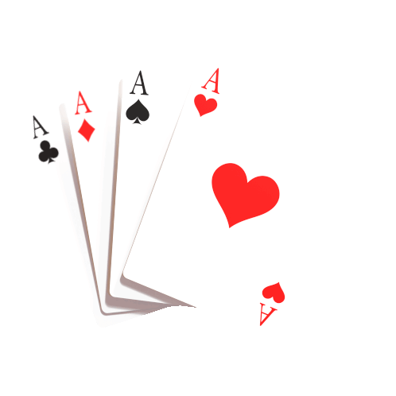
How did it go?
Positives
Managed to train the model on device
Better accuracy with each epoch
Better accuracy after federated learning
Network structure good from the start
Negatives
Hardware limitations → A lot of time downsizing images
Camera did not work as expected → Not able to use in the end
Federated learning → A challenge

Slide 8
Demo

Slide 9

Thank you for listening!
Happy Holidays!

